Slide 1
















PLATINUM
GOLD
Thank you
to our
sponsors
SILVER
BRONZE

Slide 2







CFMA Silicon Valley
Emerging Professionals Mixer
Enjoy an evening of casual networking, delicious beverages, and tasty snacks, all while mingling with the most fun and dynamic professionals in the accounting world.
April 16, 2025
4:00 PM - 6:30 PM
Joseph J. Albanese, Inc.
2450 Walsh Ave., Santa Clara
CFMA Members: $35
CFMA Non-Members: $45

Slide 3


CFMA Silicon Valley’s
BEER FEST
15 May 2025
3:30 PM - 6:00 PM
Laughing Monk Brewery
1235 Oakmead Pkwy., Sunnyvale
CFMA Members: $85
Non-Members: $95
At The Door: $105

Slide 4



SCHOLARSHIP
PROGRAM
About Us
Deadline:
May 1, 2025
The Construction Financial Management Association, Silicon Valley Chapter (“CFMA-SV”) is offering five scholarships to eligible students for the 2025-2026 academic year. CFMA-SV awards scholarships to assist students with the cost of their books, classes, housing, tools and supplies needed to further their education.
Apply Now

Slide 5



Stand up for suicide prevention
Construction has the highest suicide rate of all occupations. Help someone in trouble.
Ask.
Listen.
Encourage them to seek help.
www.cfma.org
National Suicide Prevention Hotline: 800-273-TALK
Crisis text line: HELLO to 741741

Slide 6
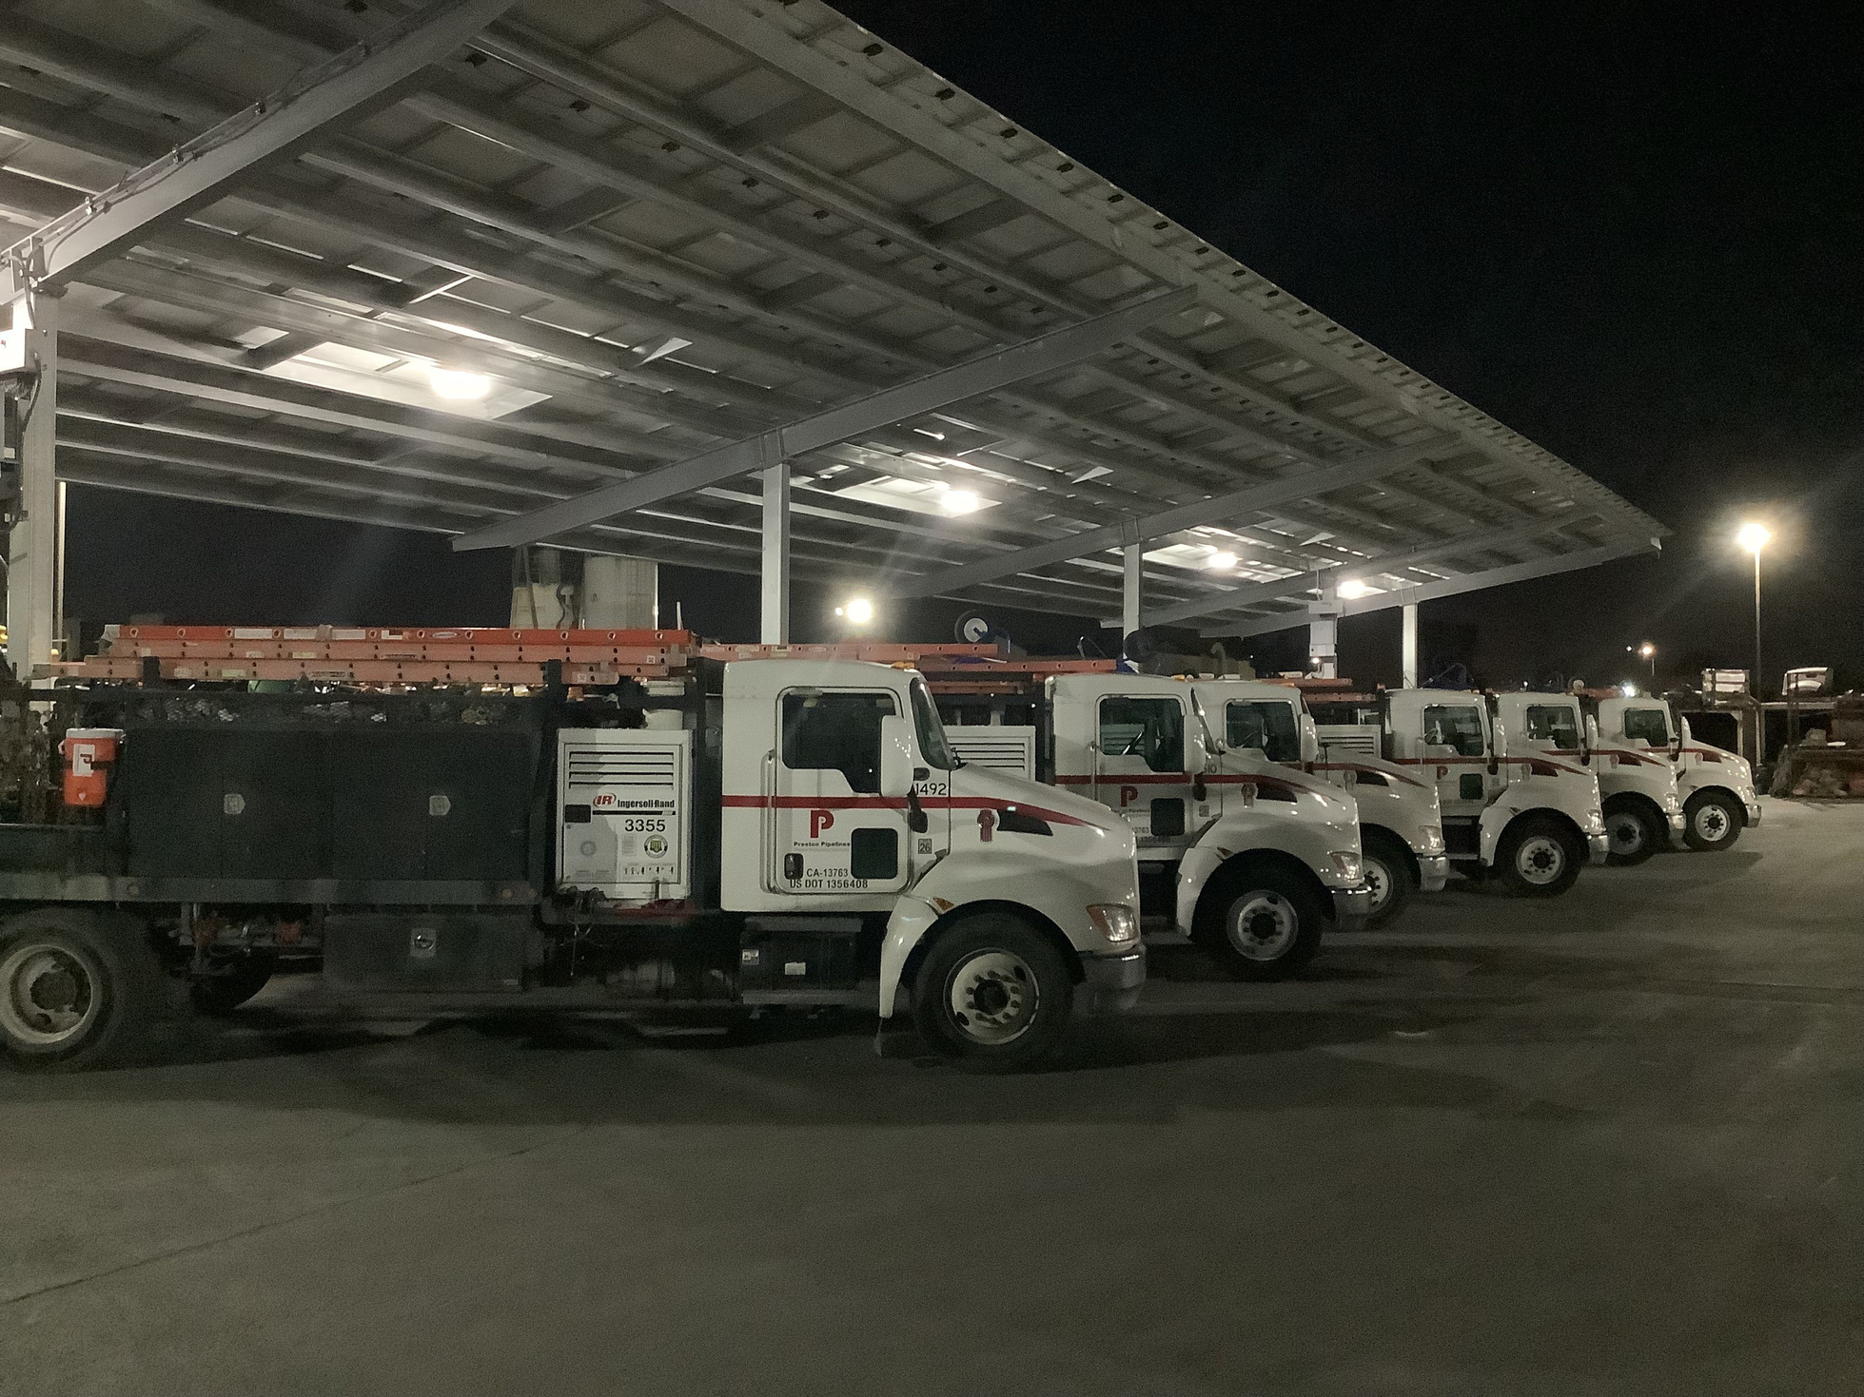
SILICON VALLEY CFMA
Transport Safety
Best Practices

Slide 7


Kyle Preston,
VP Fleet Management
Preston Companies
Presented by
Fred Jamall Jordan,
Partner/Account Manager
Geotab

Slide 8
Preston Companies
Preston Pipelines Infrastructure
Preston Electric
DirtMarket

Slide 9

Fleet Management Facts
Value of Vehicles and Equipment Owned
$80M
Maintenance Dept. Annual Budget
$20M
Vehicle and Equipment Annual Purchases
$5M
Number of Road Vehicles
280 ea
Number of Maintenance Dept and Transport Staff
50 ea
not counting an additional 50 crew truck drivers

Slide 10
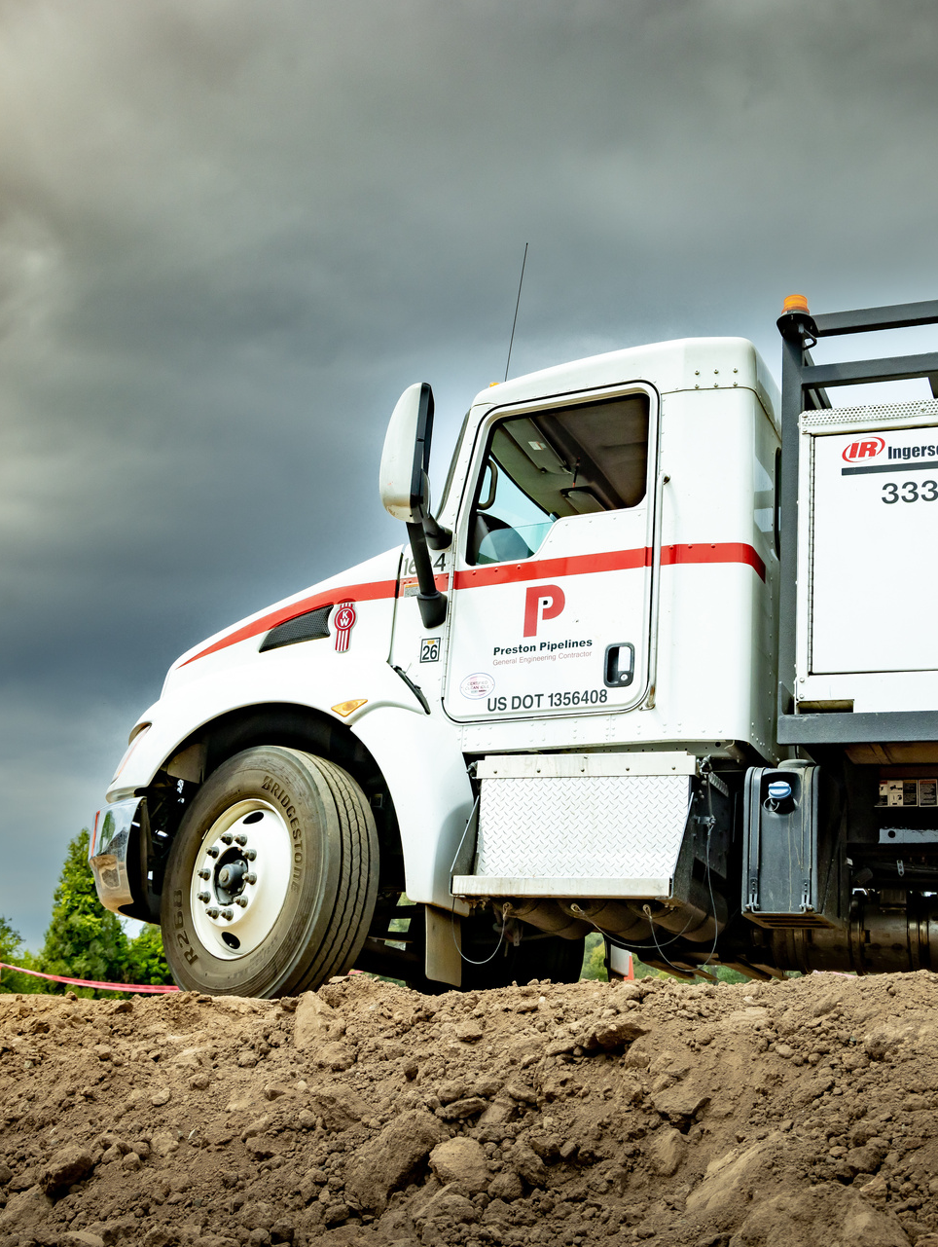
Is Fleet Management worth the cost?
We believe it is
Property damage, personal injury, Regulatory Agency Fines (DMV, DOT, CARB), insurance claims, claims impact future insurance costs, lawsuits, damage to Preston brand

Slide 11
Vehicles in the Fleet
Field staff and Foreman pick ups
Staff
Safety
Delivery
Superintendent and Foreman Pick ups, Office vehicles
Crew trucks, Tool box/pipe rack secondary tool trucks
Safety Managers Vans with tools and supplies
Box trucks, Flatbeds, Transport light duty

Slide 12
Vehicles in the Fleet
Material Hauling
Transporting Equipment
Project-specific
Task-specific
Maintenance Department
Bobtail dumps, End dumps, Super dumps, Concrete mobile mixers
Transport with trailers, Heavy duty transport with trailers
Hydrovac trucks, Street sweepers, Water trucks, ATV
Flatbed with fusion rig, Sawcut/Grinding/
Hole saw truck
Fuel trucks, Mobile mechanics trucks with crane

Slide 13
Driver training and management
Transport rules and practices
Discussion Topics
Maintenance and repair practices
Documentation and reporting
Vehicle and equipment replacement

Slide 14

Good drivers do not succeed alone; success requires giving them lots of help.

Slide 15
People Management and Training
Driver Requirements
Licensing
Clearing House
Preston Drug Testing
CA DMV license per weight/class of vehicle, endorsements for product being hauled
Fed and CA driver physicals and drug testing
At hire and upon incident

Slide 16
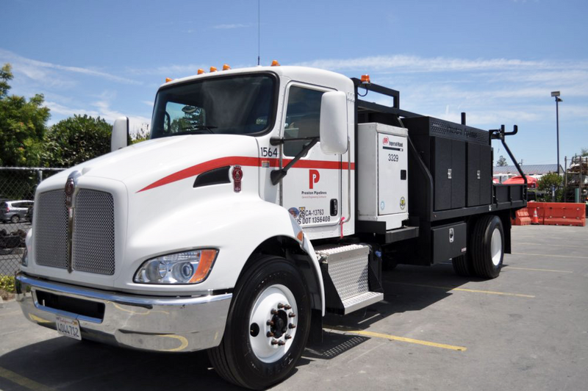
Crew Truck Drivers
Also daily delivery drivers with limited time to load and get on the road
  We provide a list in their specific mailbox identifying materials/specialty tools to bring
  We have a numbered parking stall with only their items pre-staged
  We have yard staff starting at 5:30 AM to help them load
  We fabricate and maintain a clean, organized truck bed so they have room to safely set materials for travel to the job site

Slide 17
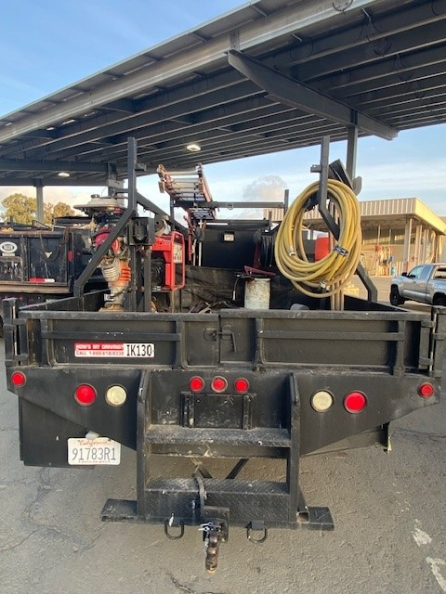
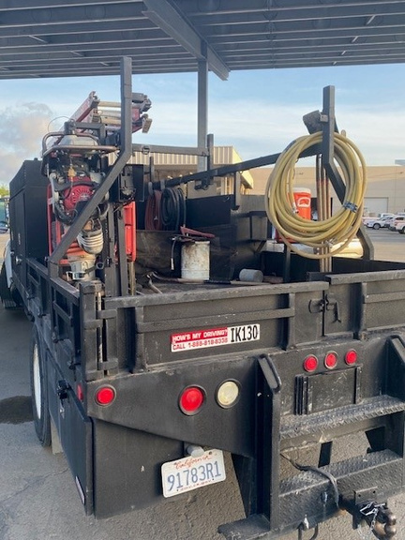
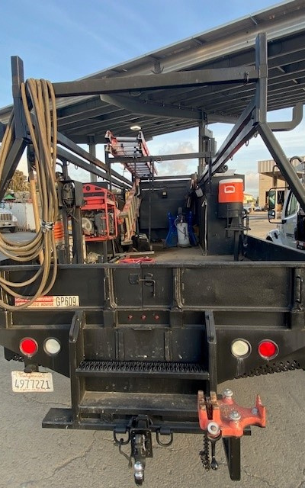
Preston
Crew Trucks

Slide 18
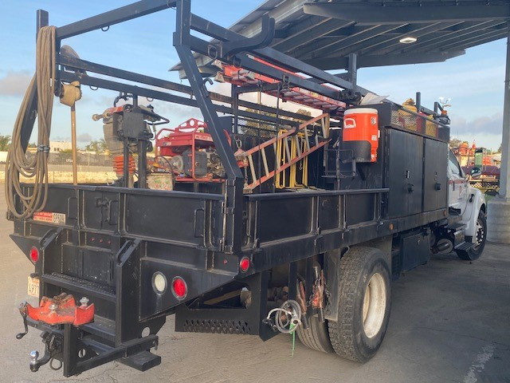
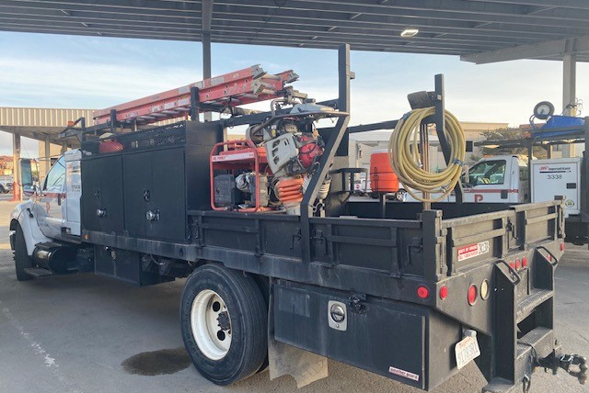
Crew Truck Organization
  Crew truck is appropriately sized to carry all team tools
  Storage and racking are Preston fabricated.
  Designed for ergonomics and ease of load/unload.
  Designed for space to stand without trip hazards
  Designed for floor space for extra daily loads

Slide 19
People Management and Training
Driver Safety Training
Securing the Load
Loading and Unloading
Daily Walk Around and Inspection Checklist
Driver Specific Training
Securing the Load – Preventing public damage/injury
  Tie down
  Loose material
  Sideboards
  Tarps
  Weight distribution – axles
Preventing personal injury
Crew truck operation
  Trailer connections/lights
  Engine and tires
  Inspection checklist documentation (daily)
  Minor repair requests
  Safety officer inspection prior to exit at our facilities gates

Slide 20
People Management and Training
Driver Reporting/Oversight
Pull Notices
Weigh Scales Violations
Telematics
License violations – tickets, DUI
Weight load regulations, HAZ documentation, equipment in disrepair
Cameras
  Safe driver practices – attentiveness, phone, hands on wheel
  Rear cargo area – load security
  Public cause/effect – insurance fraud or minimizing degree of guilt
Diagnostics (16 Data Points)
  Fleet data for safety – driver behavior requiring retraining (excessive braking…)
  Vehicle performance statistics
  Crash notification

Slide 21
Transport Rules and Practices
Dispatch - Transport Safety Management
Properly licensed people assigned to drive
Proper permitting to move equipment
Correct transport vehicle for particular equipment/material
Driver’s daily schedule to match allowable work hours

Slide 22
Transport Rules and Practices
Dispatch - Transport Safety Management
Civic Rules - Haul route/Noise restrictions – days and times
Street sweeping and cleanliness
Telematics provides GPS overlay of vehicle location/traffic

Slide 23
Transport Rules and Practices
Drivers Personal Responsibility
Properly licensed people assigned to drive
Proper permitting to move equipment
Correct transport vehicle for particular equipment/material
Driver’s daily schedule to match allowable work hours
Driver’s daily schedule to match allowable work hours

Slide 24
Maintenance and Repair Practices
Maintenance/shop skills necessary at hire or train union journeymen or apprentice
Mobile vs. shop environment vs. outsource
Engines
Hydraulics
Purchasing
Welding and Fabrication
Small tools
Electrical

Slide 25
Well maintained and well-organized vehicles are safest. Importance of quick recognition and quick response.
  Fuel and lube truck – daily maintenance, hour meter readings triggering specific maintenance
  Mobile mechanics – repairs to damaged/broken immobile equipment, HAZ cleanup
  Shop mechanics – major and minor repairs, fabrication (truck beds), inspections, telematics review
  DOT 90-day inspections, DMV vehicle registrations and licensing, quarterly SMOG on regulated weight class vehicles
  Part ordering, inventory control, and cost management – rapid service = no need to use unsafe vehicles
  Sign in and out system for all vehicles – red tag anything under repair
  Small tools inspection and repair – pumps, plugs, generators for personnel safety, and functionality
  Outsource – basics (oil change) available at lower cost, but still reputable

Slide 26
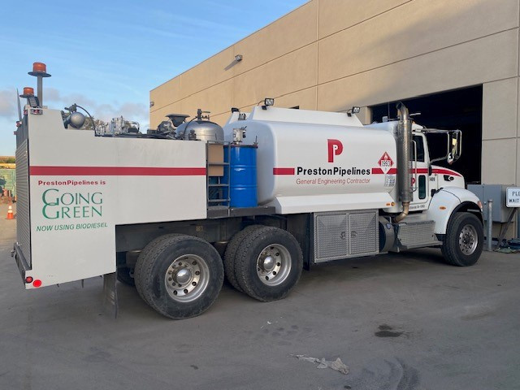
Equipment Purchases and Safety
Older vehicles and equipment
  Underpowered for the job – results in unsafe practices used to reach farther, go faster
  Leaks create hazards
  Breakage can cause injuries
New Vehicles
  Advanced safety features
  But requires training on operation
  But requires training on maintenance/repair
  Electric vs. Hydrogen vs. Hybrid vs. Combustion – emissions standards – new knowledge required – field and shop (fueling/energizing)

